Slide 1
Portfolio guidelines
Principles for effective portfolios

Slide 2
Portfolio form
All portfolios will be in electronic form.
They may be PowerPoint presentations or other digital presentations.
They must be compatible with Webcampus.
Presentations will be uploaded to a SafeAssignment.

Slide 3
More on portfolio form
Portfolios may also be websites, blogs or other Internet-based media.
It must be possible to view them without my signing into or setting up an account of any kind.
In all cases, you will also upload an email informing the hypothetical interviewer that you are making your portfolio available to them.

Slide 4
What should go into my portfolio?
This is where you use your own judgment and thereby demonstrate your understanding of principles of effective communication.
You’ll get feedback through the discussion board, which is why it is a good idea to participate fully in the discussion boards.
You can only include materials from the internship that has been approved for the class. You need permission from your supervisor to take materials from the worksite.
The strength of the portfolio is the visual dimension. Visually engaging material works best in a portfolio.

Slide 5
Consider your audience
Your audience is a potential interviewer. Ask yourself:
What information does the potential interviewer need to know about you? (This is different from your needs to explain yourself!)
If the employer has only a short amount of time to spend with the portfolio, how will you structure it give them a clear view of your accomplishments?
How easy is your portfolio to look through? How easy is it for the employer to access your portfolio?

Slide 6
Artifacts need annotation
Artifacts are communicative objects that visually convey your accomplishments.
Title your artifacts according to the skill or accomplishment they show. Do not label them “Artifact.”
However, to clearly highlight the accomplishment the artifact is meant to convey – use annotation.
Annotations accompany the artifact they relate to. They add information to help the interviewer really get your point. Do not label them “Annotation.”

Slide 7
What is annotation?
Annotations briefly state explicitly whatever the point of the artifact is.
There is no one correct way to do annotation. That is for you to decide, and thereby demonstrate your understanding of principles of effective communication. However, text blocks are less effective than bullet points.

Slide 8
Example of an annotation for a flow chart of a class assignment.
The next slide shows an example of a flow chart accompanied by an annotation explaining what the flow chart shows.
Note: the annotation adds the information about amount and type of work.

Slide 9
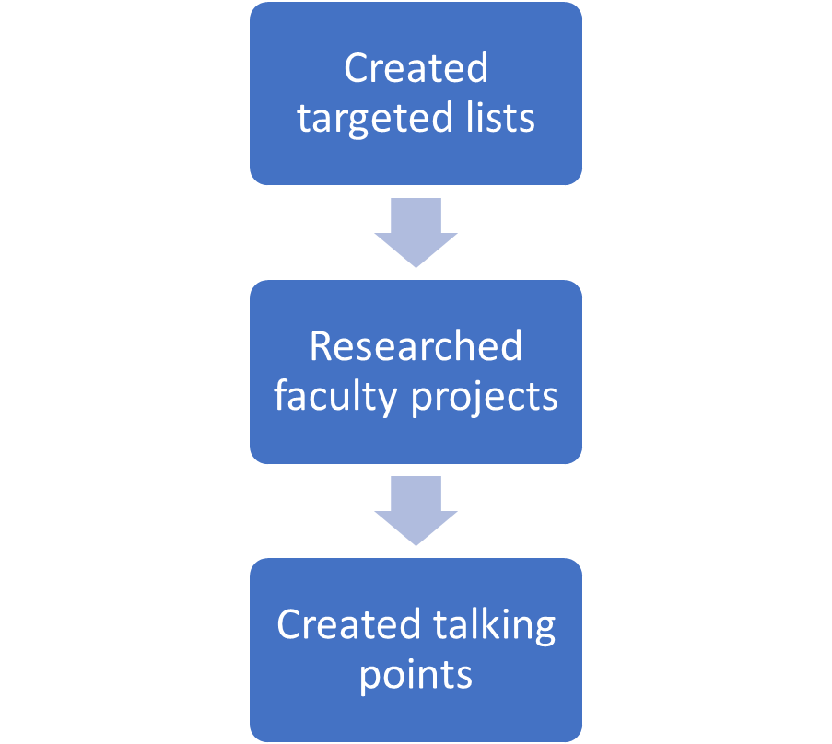
Supporting donor visits
Sorted provided donor lists by degree area and location.
Researched faculty projects of possible interest to donors in respective degree areas.
Created talking points about projects, noting relevance to donor state/town.
Matched projects to over 100 donors across 28 degree areas and 15 states.

Slide 10
What about my resumé?
Include a resumé if you wish. It is not part of the grade. I will give you feedback as time allows.
Same goes for a cover letter.

